Slide 1
Installation
Slide <number>

Slide 2


introduction
Transitioning to new systems involves managing change from pre-existing norms and habits.
Change management involves:
  Unfreezing -- loosening up peoples’ habits and norms
  Moving -- transition from old to new systems
  Refreezing -- institutionalize and make efficient the new way of doing things
Slide <number>

Slide 3
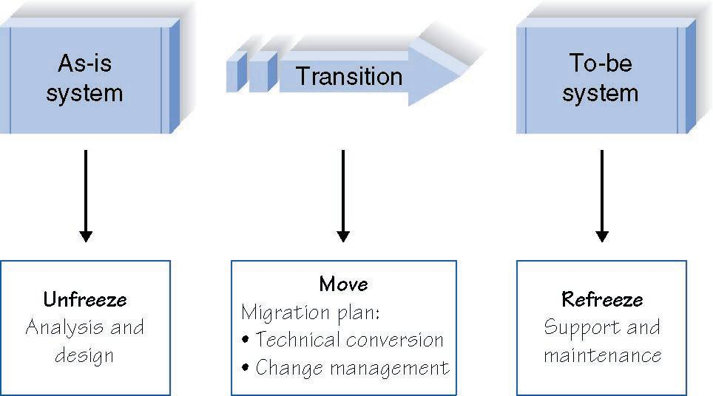
Implementing Change
Slide <number>

Slide 4


introduction
Post-implementation activities include providing:
  System support, such as help desks
  Systems maintenance, fixing bugs and providing improvements
  Project assessment, learning how to improve from project experiences
Slide <number>

Slide 5
CONVERSION
Slide <number>

Slide 6


Migration Planning
What activities will be performed when and by whom
  Technical aspects
    Installing hardware and software
    Converting data
  Organizational aspects
    Training users on the system
    Motivating employees to use the new system to aid in their work
Slide <number>

Slide 7
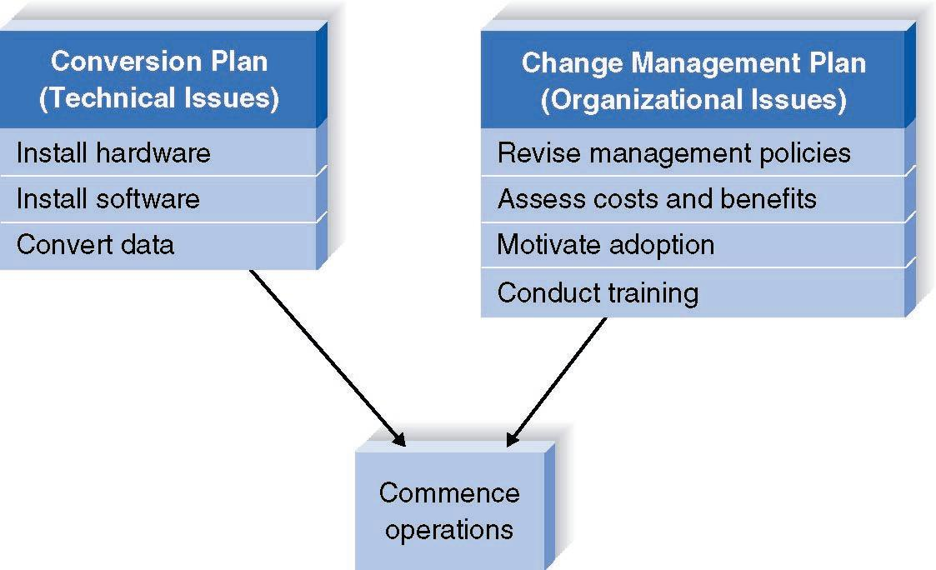
Elements of a Migration Plan
Slide <number>

Slide 8
Conversion Styles
Direct conversion
  The new system instantly replaces the old
Parallel conversion
  For a time both old and new systems are used. The old is abandoned when the new is proven fully capable
Slide <number>

Slide 9

Conversion Styles
Pilot conversion
  One or more locations are converted to work out bugs before extending to other locations
Phased conversion
  Locations are converted in sets
Simultaneous conversion
  All locations are converted at the same time
Slide <number>

Slide 10
Conversion Modules
Whole system conversion
  All modules converted in one step
Modular conversion
  When modules are loosely associated, they can be converted one at a time
Slide <number>

Slide 11
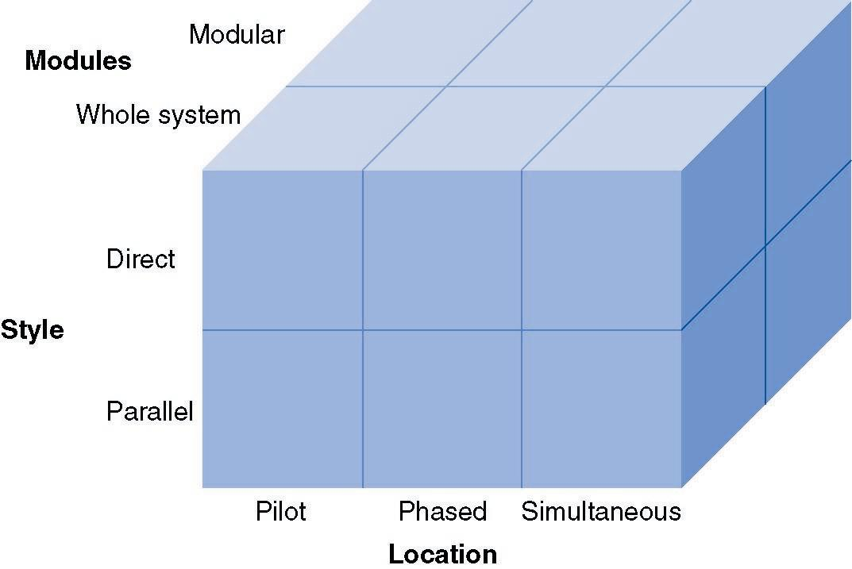
Conversion Strategies
Slide <number>

Slide 12

Key Factors in Selecting a Conversion Strategy
Risk
  Seriousness of consequences of remaining bugs
Cost
  Parallel requires paying for two systems for a period of time
  Simultaneous requires more staff to support all locations
Time
  Parallel, phased, and modular require more time
Slide <number>

Slide 13
CHANGE MANAGEMENT
Slide <number>

Slide 14
Key Roles in Change Management
The sponsor is the business person who initiated the request for the new system
The change agent is the person(s) who lead the change effort
The potential adopter(s) are the people who must change.
Slide <number>

Slide 15
Understanding Resistance to Change
What is good for the organization, is not necessarily good for the individuals who work there
Cost versus benefit of transition as well as of to-be system
Adapting to new work processes requires effort, for which there may be no additional compensation
Slide <number>

Slide 16
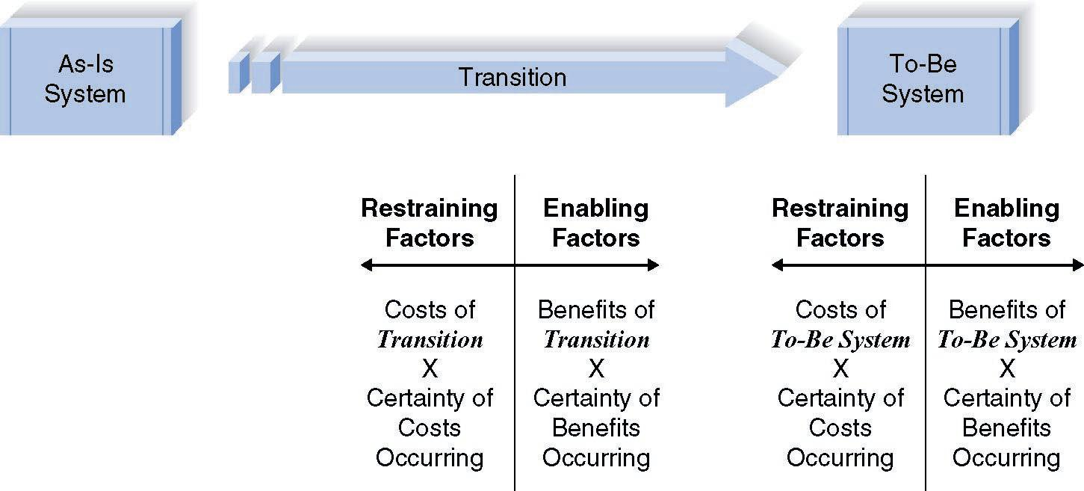
Costs and Benefits of Change
Slide <number>

Slide 17
Revising Management Policies
No computer system will be successfully adopted unless management policies support its adoption
Management tools for supporting adoption
  Standard operating procedures (SOPs)
  Measurements and rewards
  Resource allocation
Slide <number>

Slide 18
Assessing Costs and Benefits
What Actions
Will
Encourage
the Fullest
Measure of
Each Factor?
Factors in Successful Change
Benefits of to-be system
Certainty of benefits
Costs of transition
Certainty of costs
Slide <number>

Slide 19
Motivating Adoption
The information strategy aims to convince adopters that change is better
The political strategy uses organizational power to motivate change
Differentiate between ready adopters, reluctant adopters, and resistant adopters
Slide <number>

Slide 20
Training
Every new system requires new skills
New skills may involve use of the technology itself
New skills may be needed to handle the changed business processes
Slide <number>

Slide 21
What to Train
Should focus on helping users accomplish their tasks
Use cases provide an outline for common activities and a basis to plan training
Slide <number>

Slide 22
Types of Training
When
Would You
Use Each of
These
Training
Methods?
Types of Training
One-to-One
Classroom
Computer-Based
Slide <number>

Slide 23
POST-IMPLEMENTATION ACTIVITIES
Slide <number>

Slide 24
Institutionalization of the System
Provide support
  Assistance in using the system
Provide maintenance
  Repair or fix discovered bugs or errors
  Add minor enhancements to provide added value
Assess the project
  Analyze what was done well
  Discover what activities need improvement in the future
Slide <number>

Slide 25
Types of System Support
On-demand training at time of user need
Online support
  Frequently asked questions (FAQ)
Help desk
  Phone service for known issues
  Level 2 Support
Slide <number>

Slide 26
Sources of Change Requests
1. Problem reports from the operations group
2. Requests for enhancements from users
3. Requests from other systems development projects
4. Change requests from senior management
Slide <number>

Slide 27
System Review
Examine the extent to which the costs and benefits of the system are realized
Use this information to help in more accurately estimating costs and benefits for future projects
Slide <number>

